Slide 1


Handwritten Digit Recognition using Neural Networks
Exploring the MNIST dataset to build an intelligent model that automatically classifies handwritten digits from 0 to 9. We'll leverage TensorFlow and Keras to construct a neural network capable of learning complex patterns in handwritten character data.
Arnav Gupta
Spandan Basu Chaudhuri

Slide 2
Understanding the MNIST Dataset
What is MNIST?
Dataset Composition
The Modified National Institute of Standards and Technology (MNIST) dataset is the gold standard benchmark for evaluating machine learning models in computer vision.
Training Set
60,000 images for model learning
This comprehensive collection contains 70,000 grayscale images, each measuring 28 × 28 pixels, representing handwritten digits captured from various sources.
Testing Set
10,000 images for evaluation

Slide 3
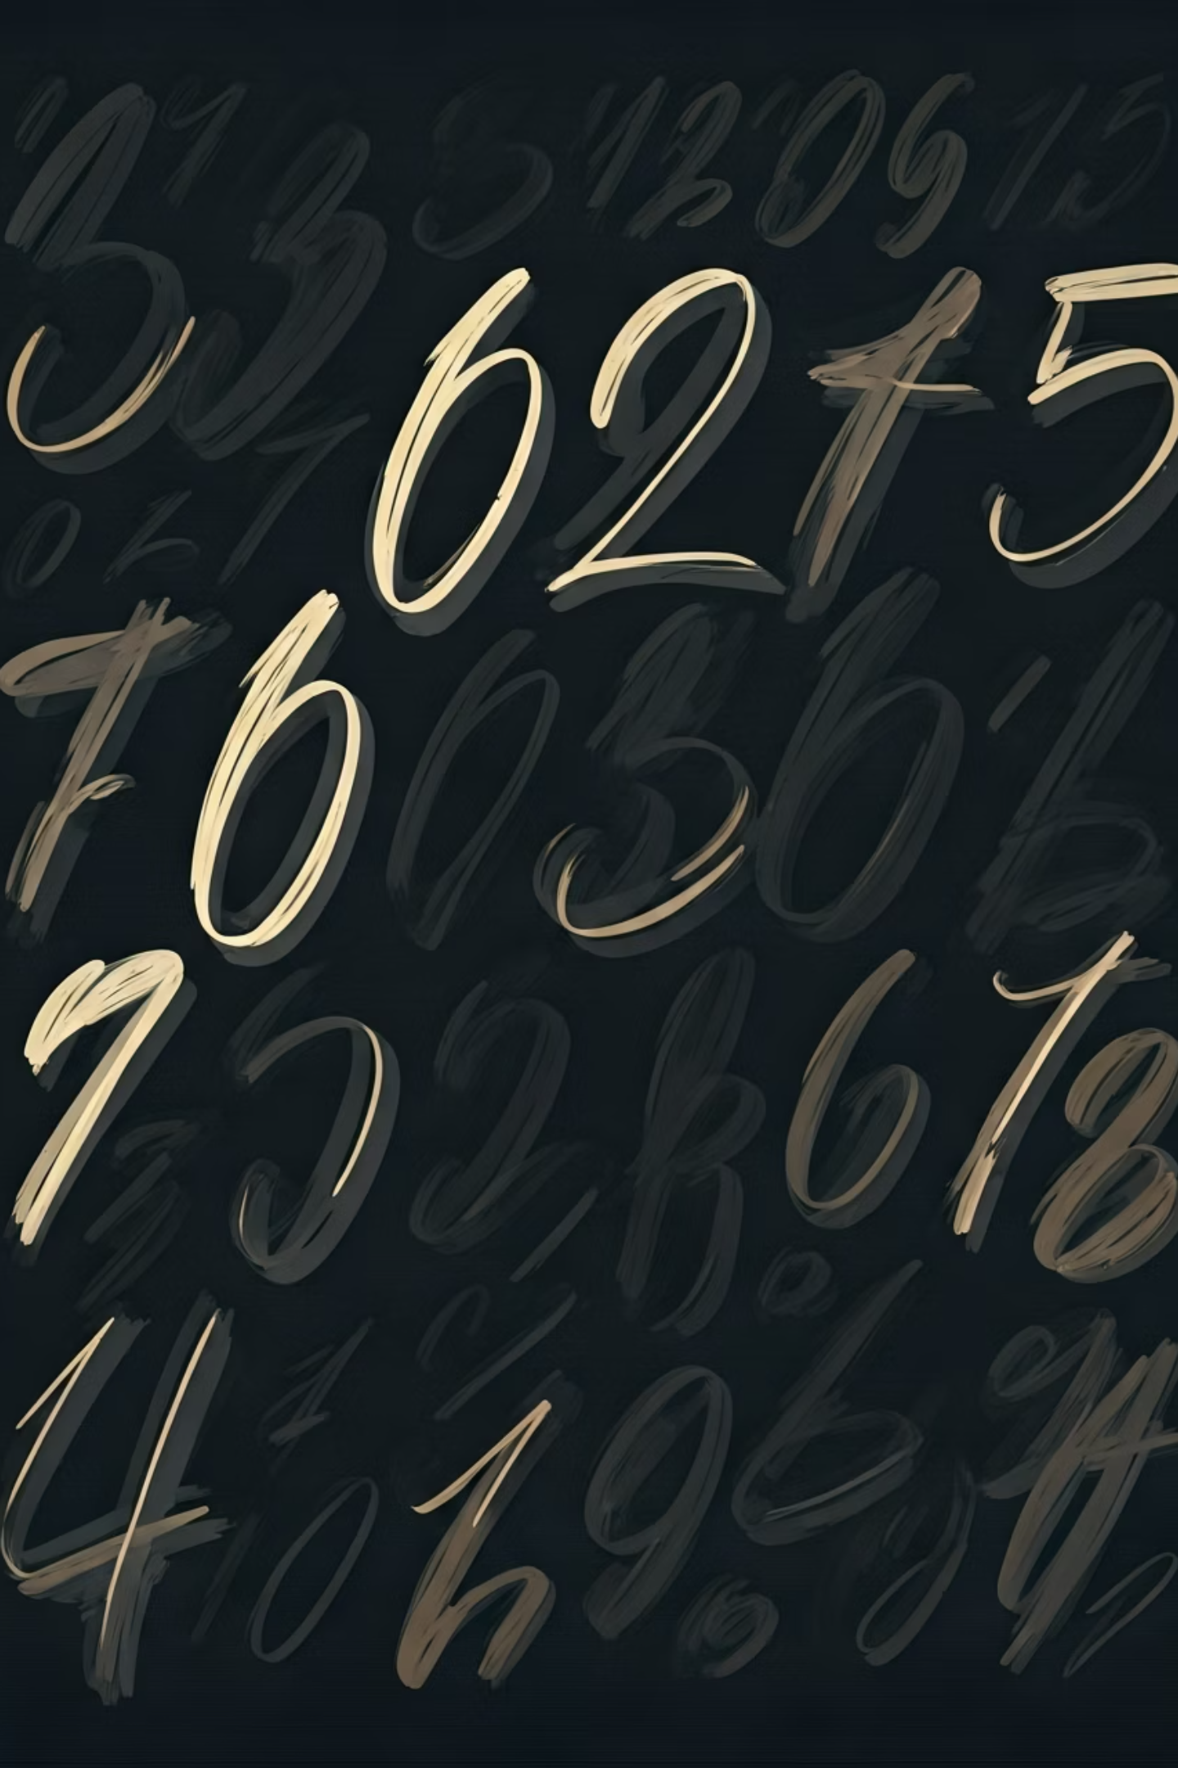

Visualizing Handwritten Digits
Each image in the dataset captures the unique characteristics of a handwritten digit. The pixel intensity values represent the stroke darkness, ranging from white background (0) to black ink (255).
Use plt.matshow(x_train[0]) to display individual digit images and examine the pixel patterns that the neural network will learn to recognize.

Slide 4
Data Preprocessing Pipeline
01
02
03
Reshape Data Structure
Normalize Pixel Values
Optimize for Training
Transform 2D arrays (28 × 28) into flattened 1D vectors containing 784 features, making them compatible with dense neural network layers.
Scale all pixel intensities by dividing by 255, converting the range from [0, 255] to [0, 1]. This normalization ensures balanced feature contributions.
Normalized data accelerates gradient descent convergence, stabilizes training dynamics, and improves overall model performance by preventing numerical instability.

Slide 5
Neural Network Architecture
Layer Type
Description
Input Layer
784 neurons (flattened 28×28 pixels)
Dense Layer 1
128 neurons with ReLU activation
Dense Layer 2
64 neurons with ReLU activation
Output Layer
10 neurons with Softmax activation
This architecture progressively reduces dimensionality while extracting increasingly abstract features, ultimately mapping input pixels to digit probabilities.

Slide 6
Activation Functions
ReLU (Rectified Linear Unit)
Softmax Activation
Introduces non-linearity into the network, enabling it to learn complex, non-linear patterns and relationships in the data. ReLU outputs max(0, x), effectively filtering negative values while preserving positive activations.
Transforms raw output scores into a probability distribution across all 10 digit classes. Each output represents the model's confidence that the input belongs to that particular digit class, with all probabilities summing to 1.
f(x) = max(0, x)
σ(z)ᵢ = exp(zᵢ) / Σ exp(zⱼ)

Slide 7

Model Compilation Strategy
Loss Function
Sparse Categorical Crossentropy — Optimal for multi-class classification with integer labels, measuring the difference between predicted and actual class distributions.
Optimizer
Adam — Adaptive Moment Estimation combines momentum and adaptive learning rates for faster, more stable convergence during training.
Evaluation Metric
Accuracy — Tracks the percentage of correctly classified digits, providing an intuitive measure of model performance.

Slide 8
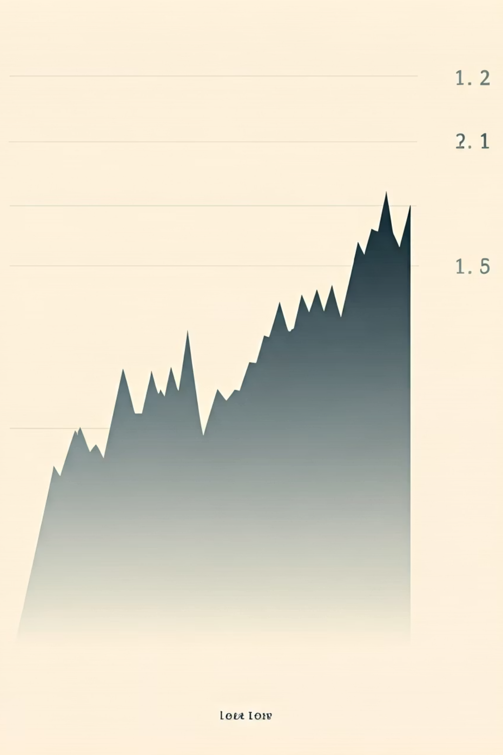
Training the Neural Network
1
Epoch 1-3
Initial weight adjustments, rapid accuracy improvements as basic patterns emerge
2
Epoch 4-7
Refinement phase with gradual loss reduction and stabilizing accuracy gains
3
Epoch 8-10
Fine-tuning and convergence, achieving optimal performance on training data
The model trains for 10 epochs, iteratively adjusting internal weights to minimize prediction errors. With each epoch, the network learns more sophisticated feature representations, progressively improving its ability to distinguish between different digit classes.

Slide 9


Results and Model Predictions
Performance Metrics
97%
10K
Test Accuracy
Predictions
Strong generalization on unseen data
Evaluated samples
Generate predictions using:
predictions = model.predict(x_test)
The trained model demonstrates excellent performance, correctly classifying approximately 97% of test samples. Visualizations comparing predicted labels against actual labels reveal the model's strengths and occasional confusion between similar-looking digits.

Slide 10
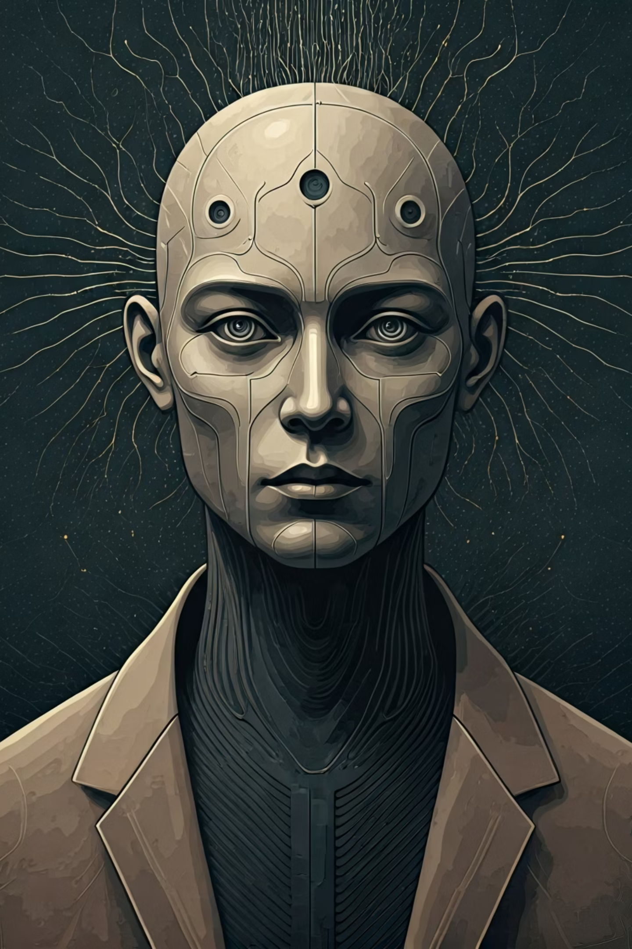
Key Takeaways and Next Steps
1
2
Achievement
Real-World Applications
Successfully built and trained a neural network achieving ~97% accuracy on handwritten digit classification
This foundational work enables Optical Character Recognition (OCR) systems for document digitization, automated form processing, and check reading
3
Future Improvements
Implement Convolutional Neural Networks (CNNs) to capture spatial hierarchies and achieve even higher accuracy (99%+) by leveraging convolutional layers

